Slide 1


Client- ASV empowerment
Final Presentation
Group 1

Slide 2



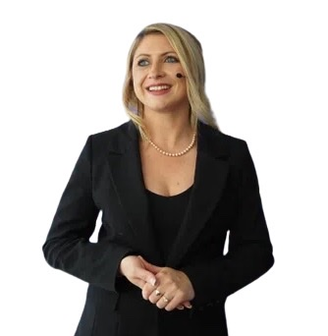
Introduction and project background
Proposed Project is to develop a comprehensive website for AVS empowerment, an organization dedicated to supporting and empowering the neurodiverse community .
The website will serve as a central platform for sales of educational services, providing webinars, blog posts, create awareness, challenge misconception and promote empathy

Slide 3
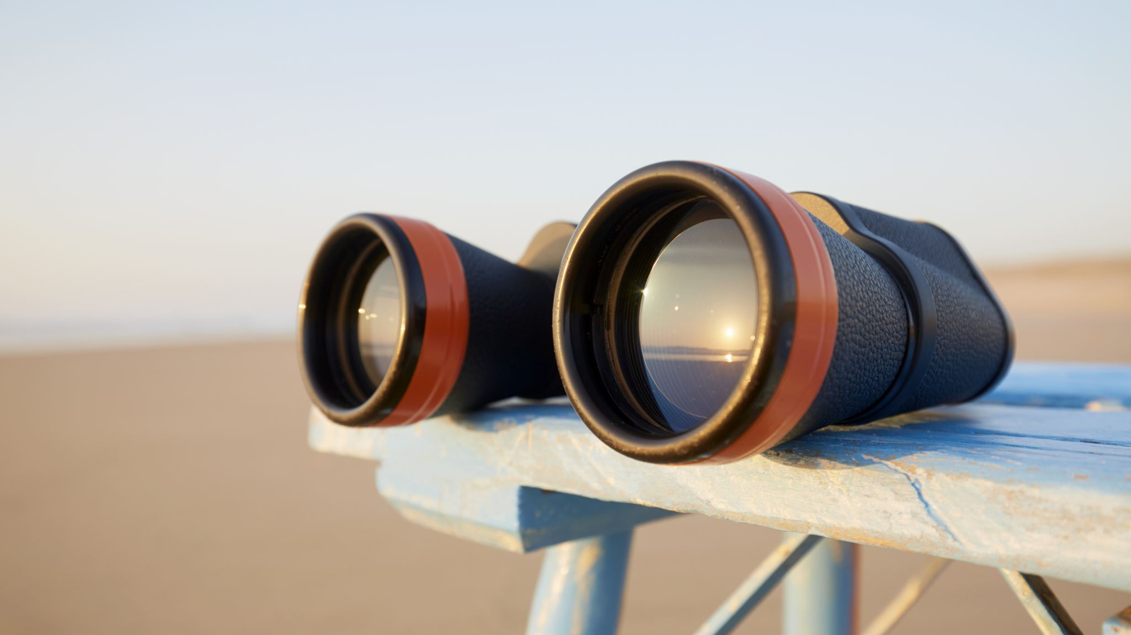
The scopes we covered

Slide 4


INTEGRATION OF SOCIAL MEDIA
JOURNEY MAP IN ABOUT PAGE
WEBSITE ANALYTICS AND SEARCH ENGINE OPTIMISATION (SEO)
FREE JOURNAL ADVERTISEMENT
PAGES AND SUBPAGES DEFINED BY THE CLIENT
SERVICE DISTINCTION BY COLOURS
EVENT PAGE
PAYMENT CONFIRMATION
POP UP QUIZ ON NEURODIVERSITY

Slide 5
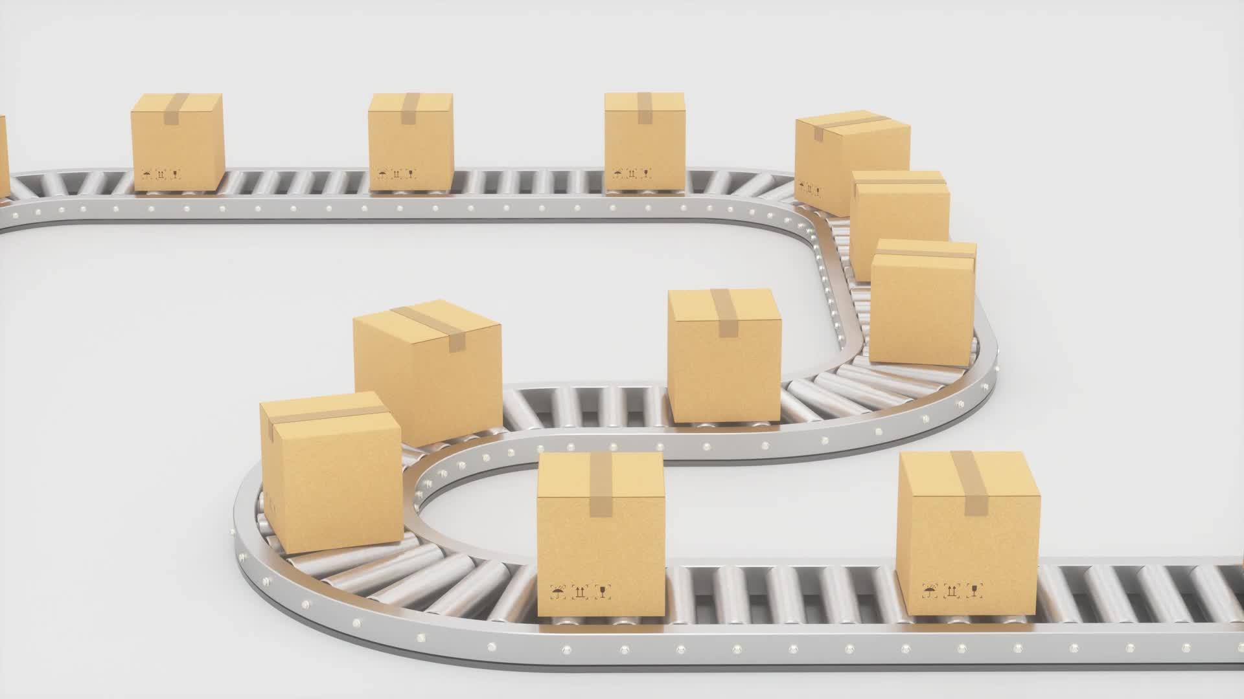
Deliverables

Slide 6
Deliverables
ALLIGNS WITH CLIENT’S GOAL AND OBJECTIVE
FRONT END DESIGN REFELCTING CLIENT’S BRAND
FRONT END DESIGN REFELCTING CLIENT’S AESTHETIC PREFERENCE
BACK UP
EASY TO FIND INFORMATION WITH SEO
EASY NAVIGATION
MOBILE RESPONSIVE
HANDLES ONLINE TRANSACTION
PAGES AND SUBPAGES DEFINED BY CLIENTS
HIGHEST SEARCH ENGINE RANKING
FULLY FUNCTIONAL

Slide 7

Methodology
This Photo by Unknown Author is licensed under CC BY-NC

Slide 8
GIVEN OUR CONSTRAINT OF TIME
WE HAVE OPTIMIZED THE USE OF A TEAM GANTT SCHEDULE THAT DISTRIBUTES OUR RESPONSIBILITIES AND HELPS ATTAIN DUE DATE BY PROJECT ORIENTED APPROACH.
GIVEN OUR CONSTRAINT OF UNCERTAINILITY OF CLIENT NEEDS
WE HAVE USED THE AGILE METHOD TO ITERETIVELY DEVELOP OUR WEBSITE TO CLIENT NEED. DISCUSSIONS , EXCHANGE OF FEEDBACKS, CONSTRUCTIVE CRITISICM AND QUESTIONS WERE CLARIFIED IN 4 CLIENT MEETINGS.
GIVEN OUR CONSTRAINT OF TECHNICAL RISKS
WE HAVE BACKED UP OUR WEBSITE , USED SOME UPDATE PLUGINS, THE HOSTING SERVER WILL PROVIDE SECURE HOSTING SERVICES.WE ARE SSL CERTIFIED

Slide 9

APPEARANCE AND design

Slide 10
APPEARANCE AND design
Our website's theme celebrates Neurodiversity with a palette of gentle hues. The peach background, adorned with subtle orange and soothing blue undertones, creates a harmonious and welcoming environment.
A Professional and Inclusive Design
Our design exemplifies professionalism while ensuring inclusivity for all visitors.
The thoughtful use of color, contrast, and typography promotes accessibility and enhances user experience.
Consistent Branding for Recognition
Consistency in branding reinforces recognition and our commitment to neurodiversity.
The peach background and complementary colors across the website reflect our identity and values.
User-Centricity at the Heart
User-centric design empowers visitors, ensuring a seamless and meaningful journey.
With consideration for user needs, our design prioritizes ease of use and engagement.
Inspiring Positive Change
Beyond aesthetics, our design aims to inspire positive change and promote understanding.
Through a visually captivating experience, we aspire to foster dialogue and empathy for neurodiversity.

Slide 11

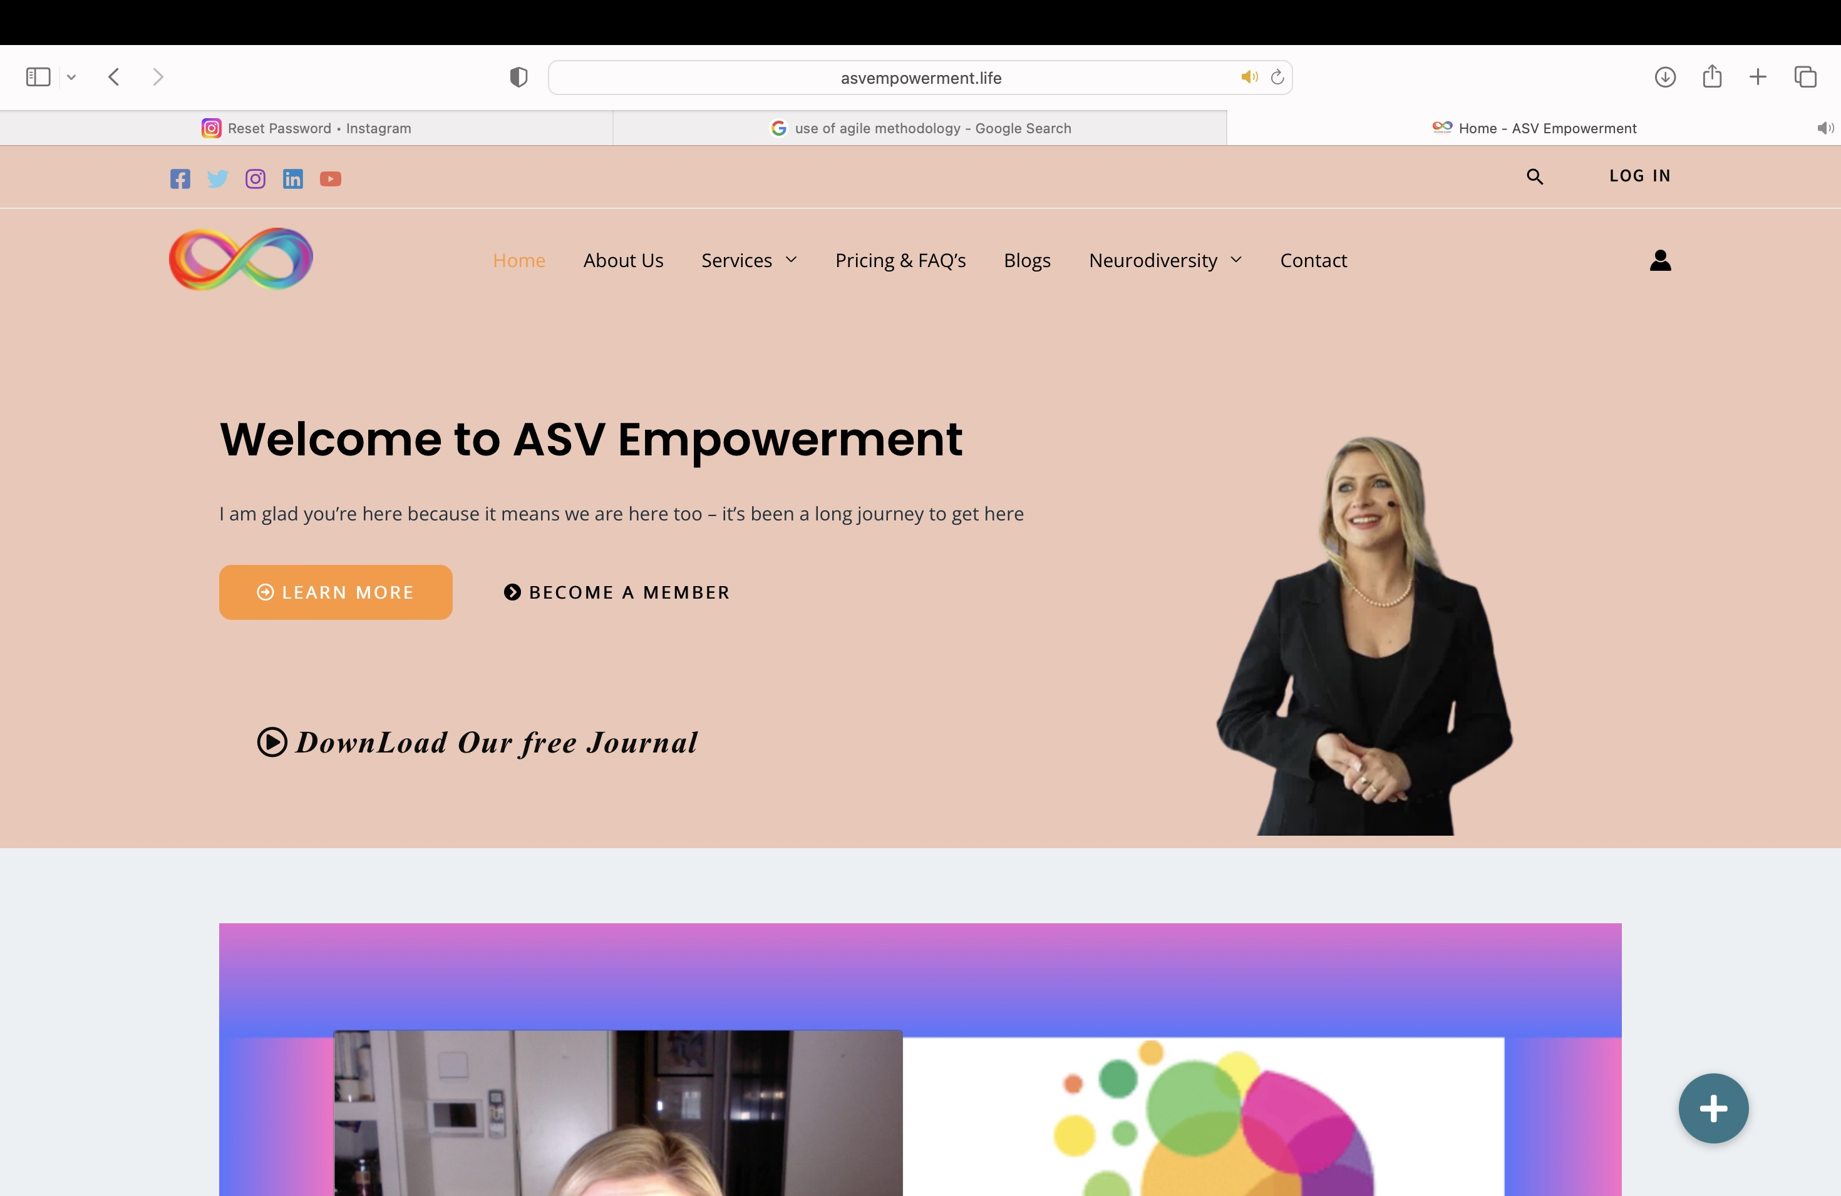
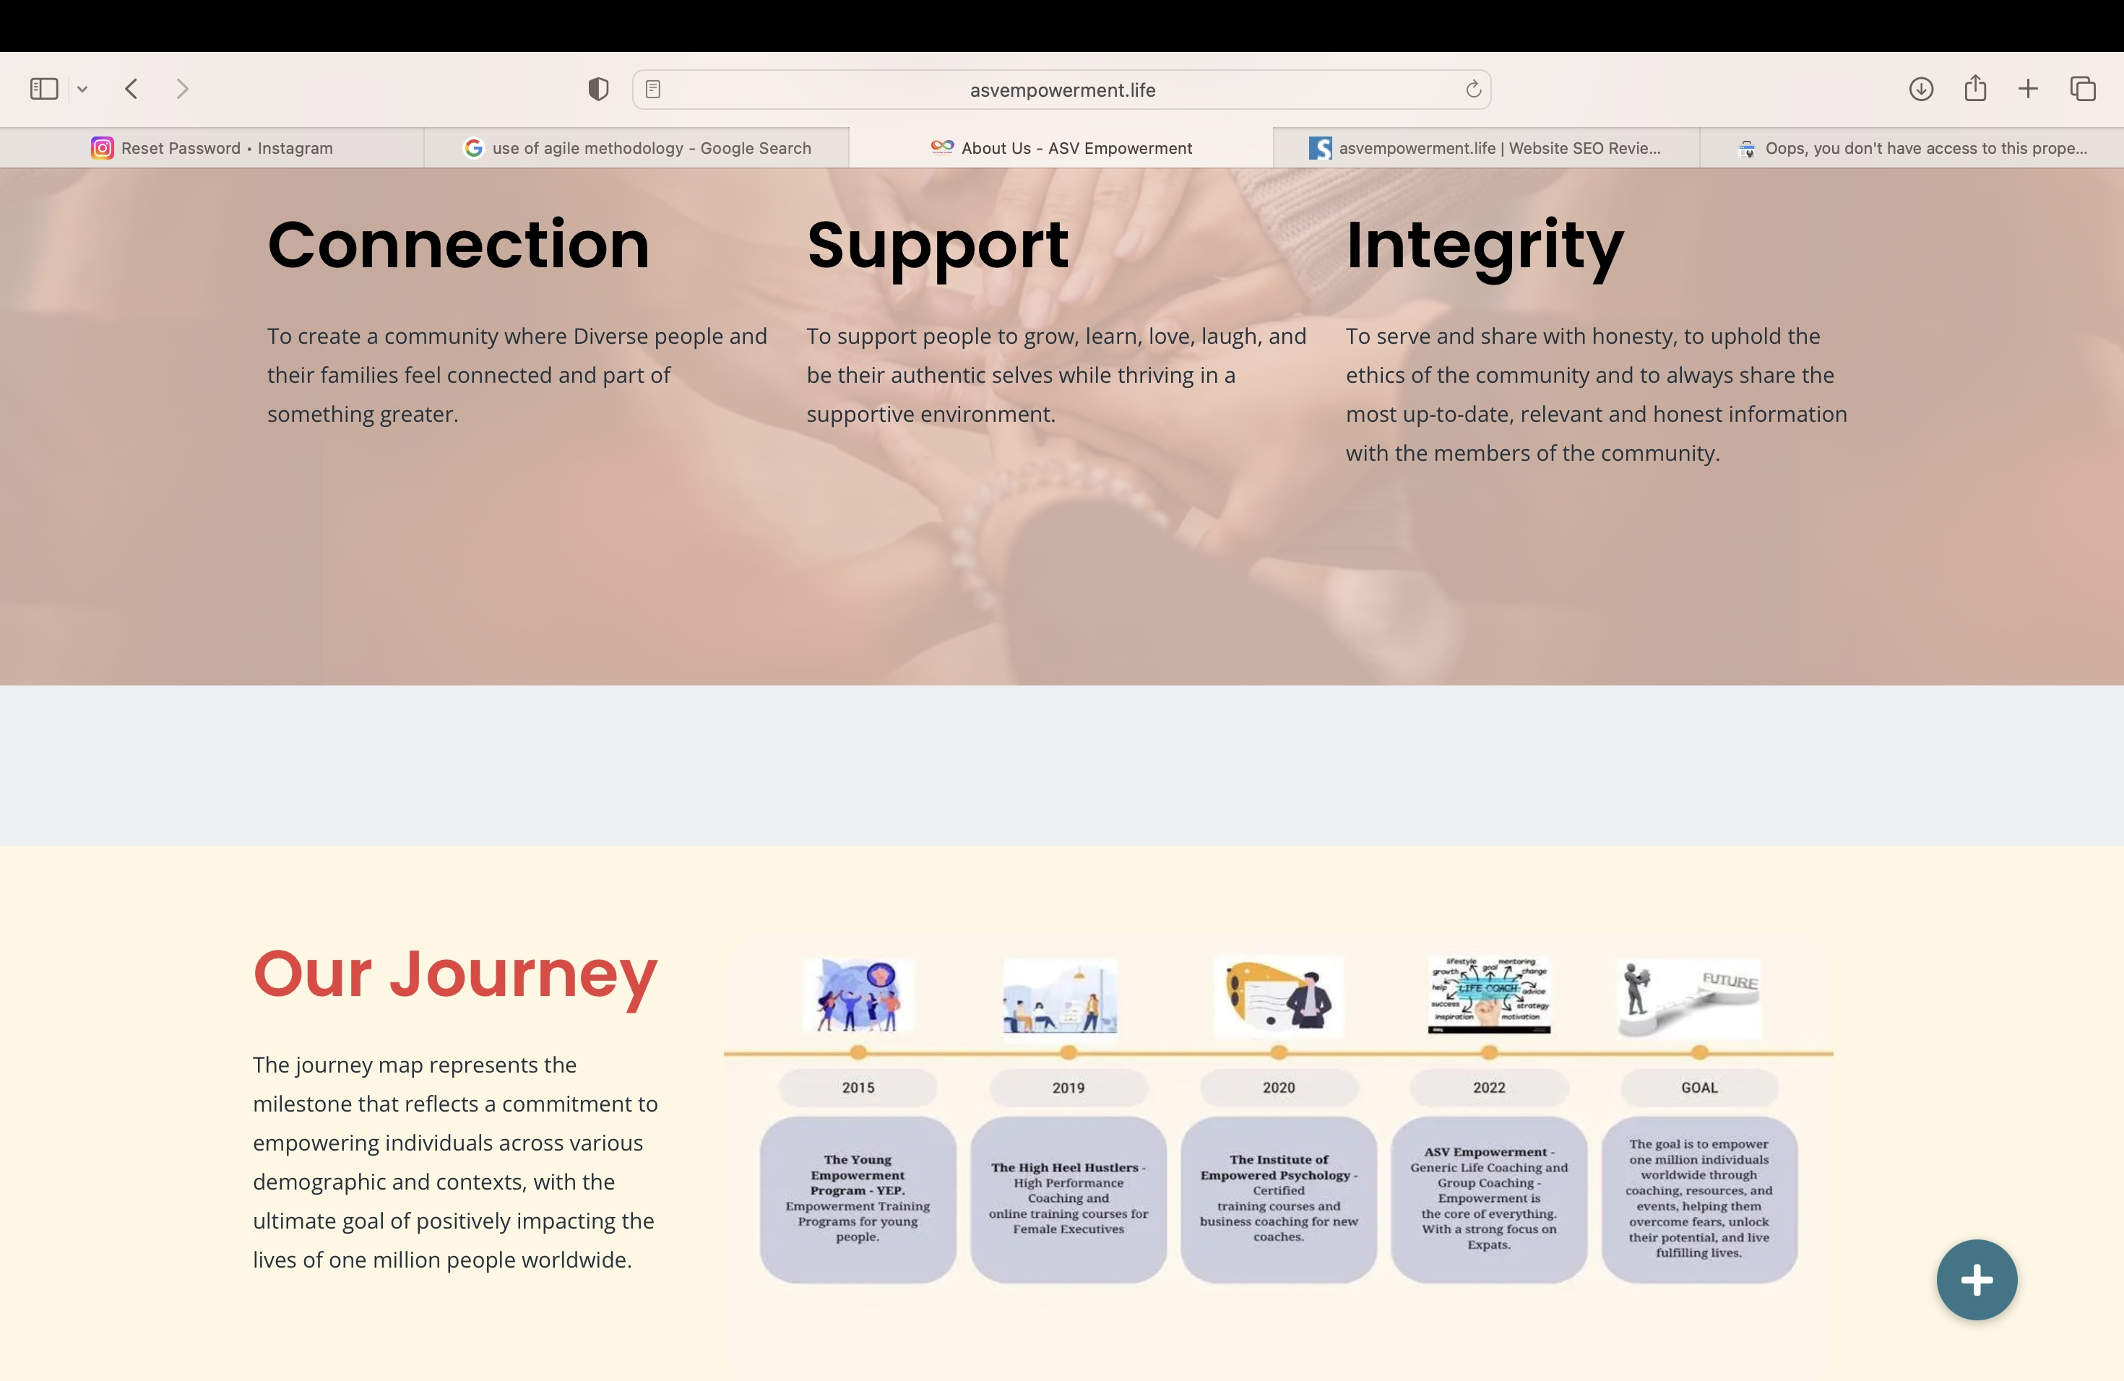
The logo
has been made with client preference of the colorful infinity neurodivergent sign .
The theme and background color
is selected to be of peach with orange and blue undertones .
Keeping in mind both serenity and boldness that the entity relates to. Minimalistic use of pictures and videos to combat cluttered appearance .

Slide 12
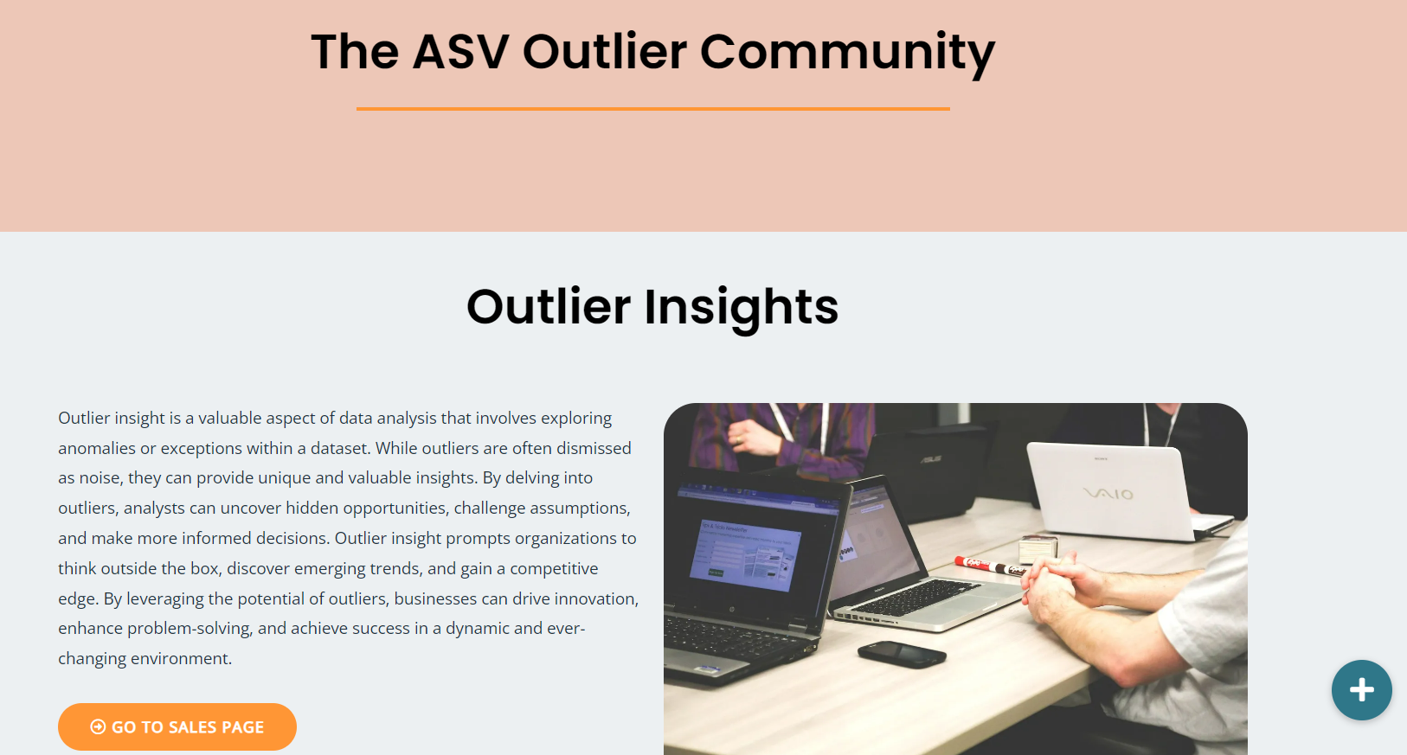
Choice of Design
Clean and Modern Layout
Typography that Speaks Volumes
Branding that Leaves an Impression
Aesthetic Unity for Cohesion
Responsive and Adaptable Design

Slide 13
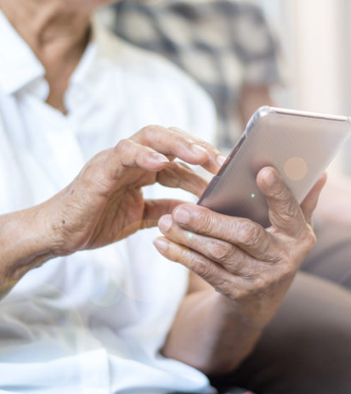
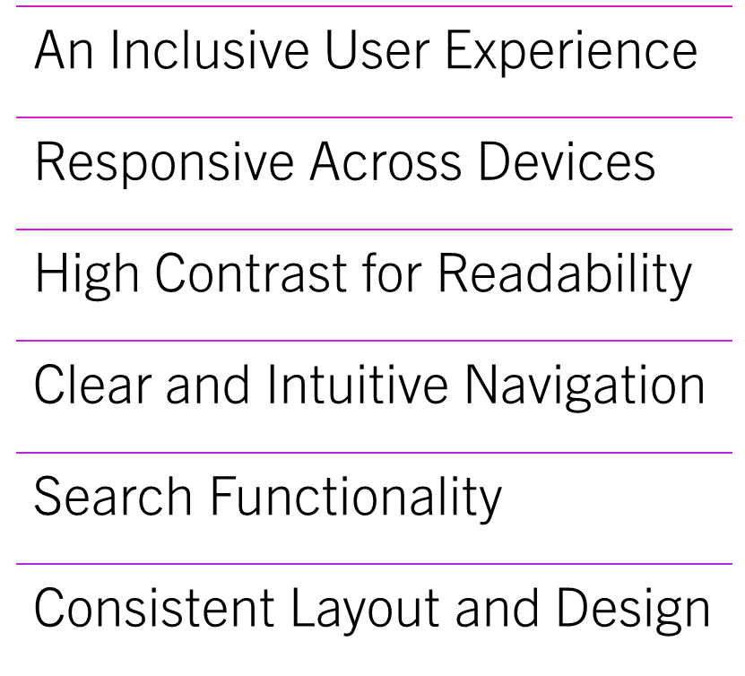
USABILITY
Usability
This Photo by Unknown Author is licensed under CC BY

Slide 14
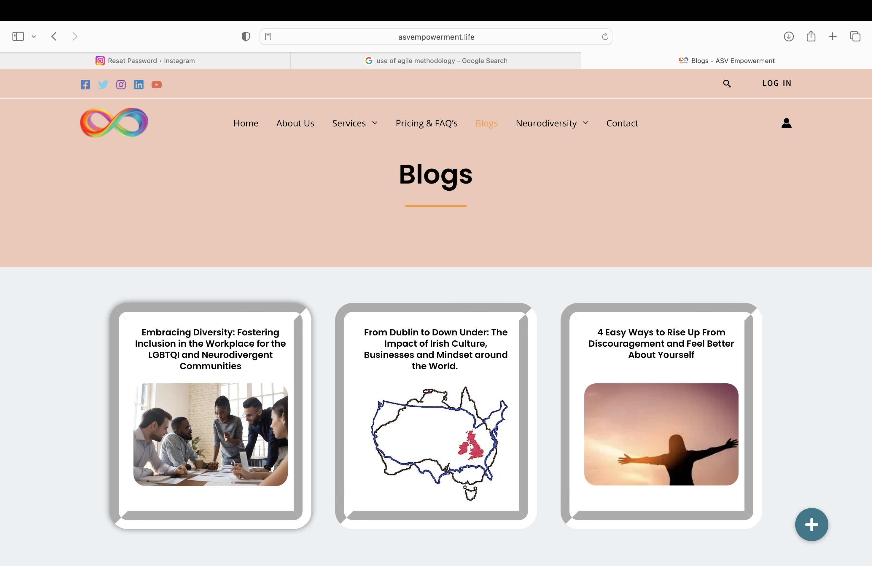
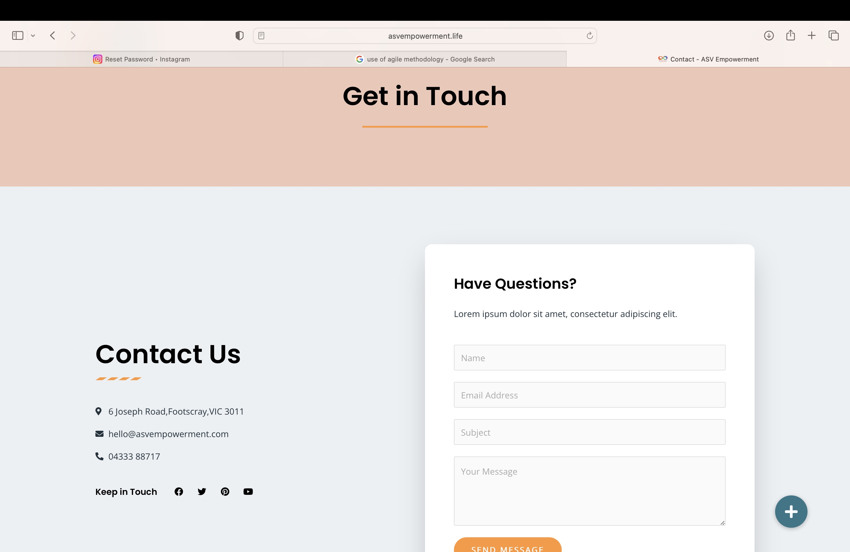
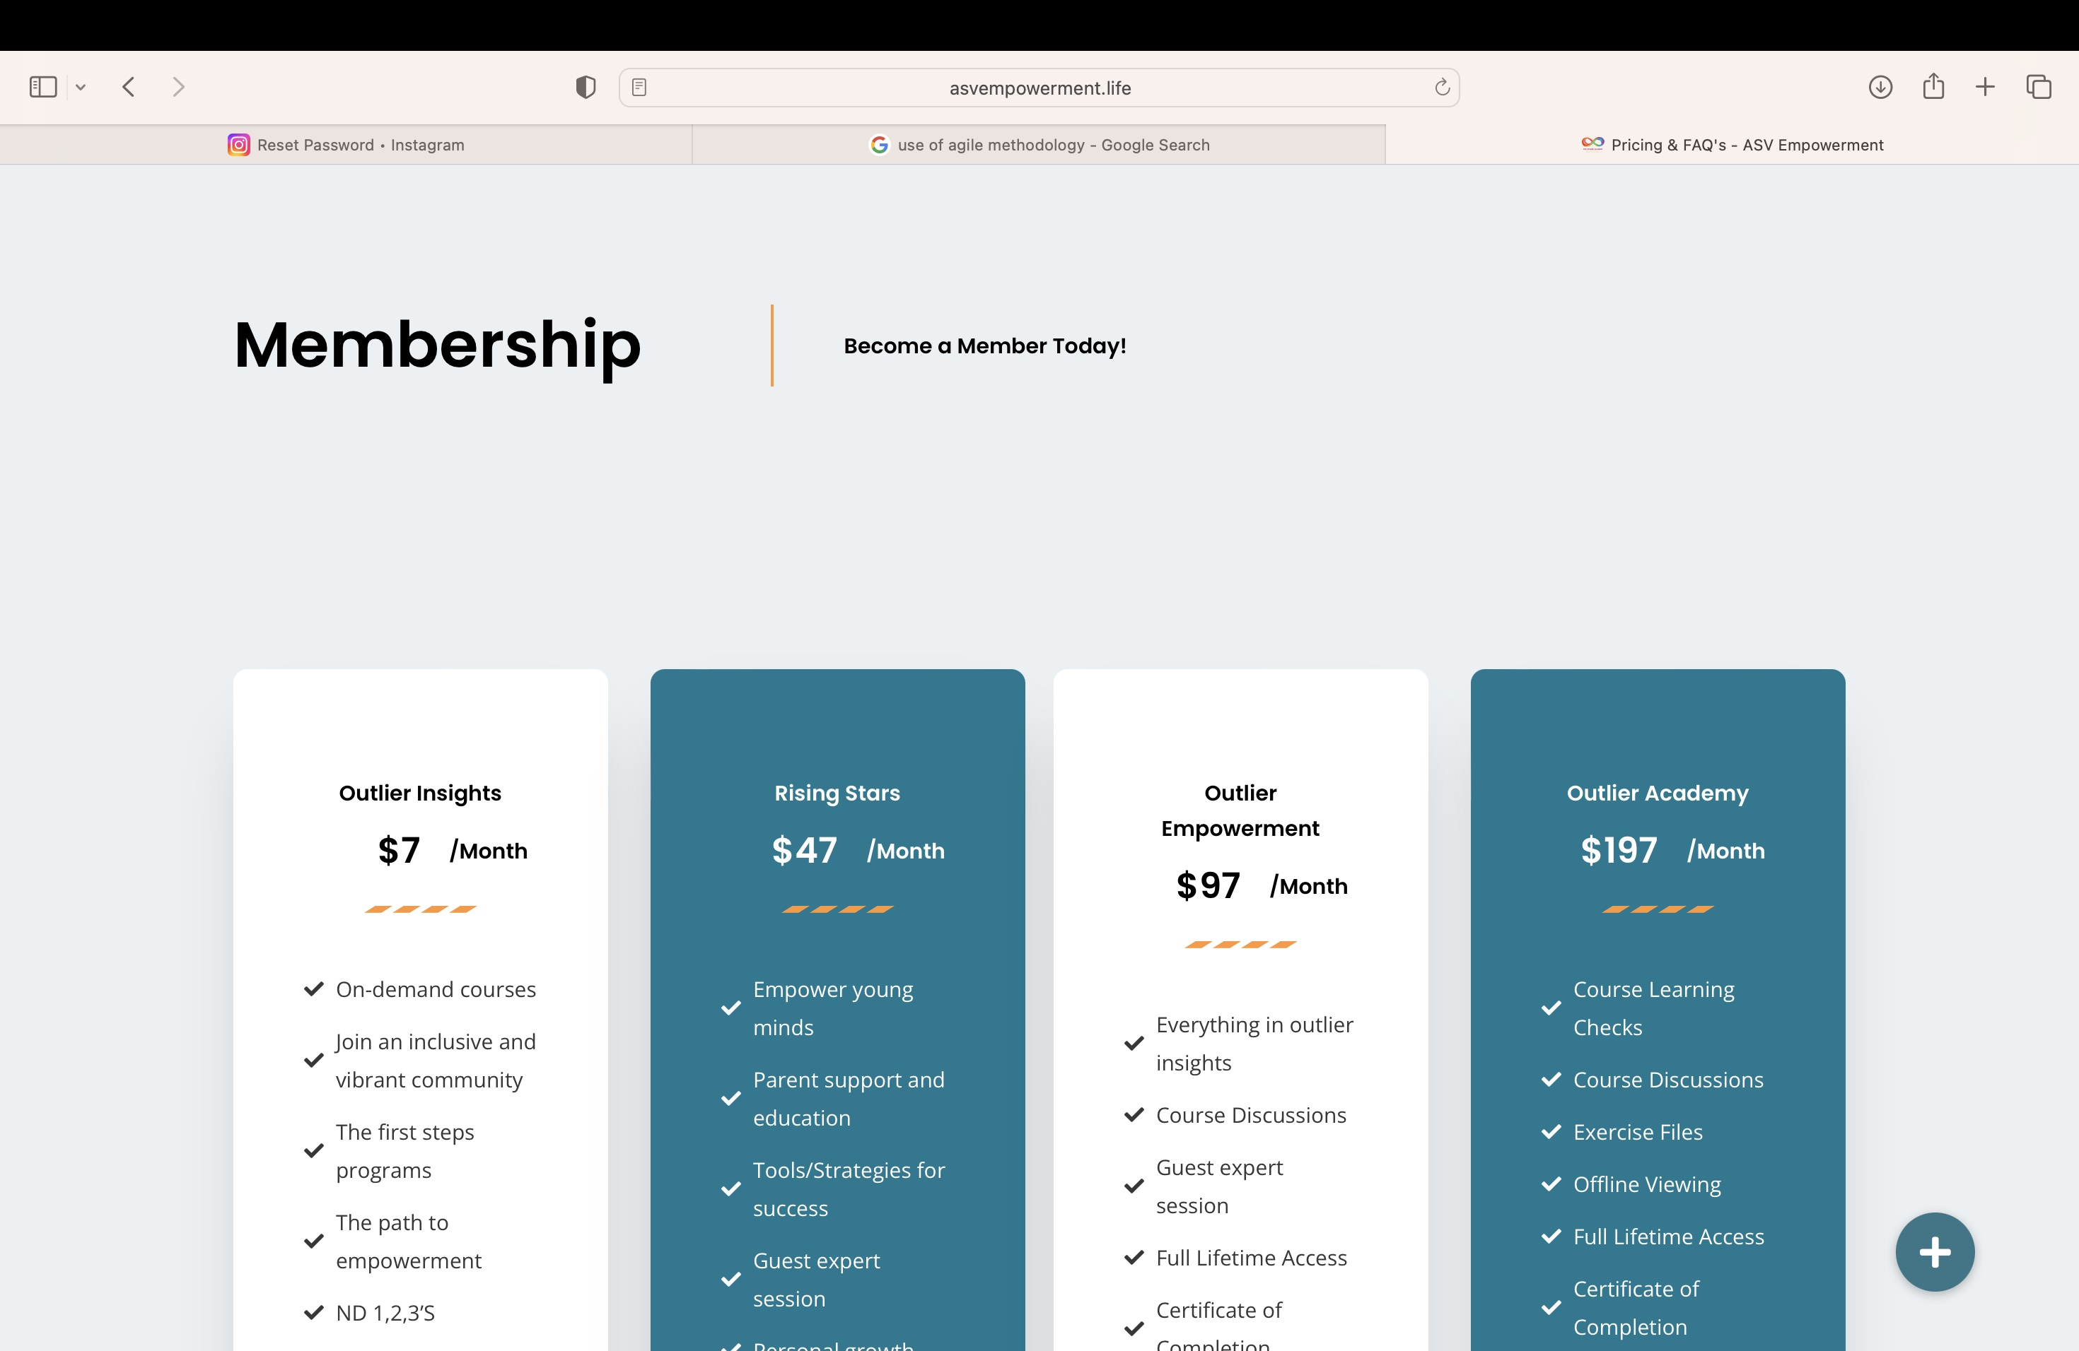
The forms made easy and simple for
Quick enrollment
Use of content forms
to allocate
Information effectively

Slide 15
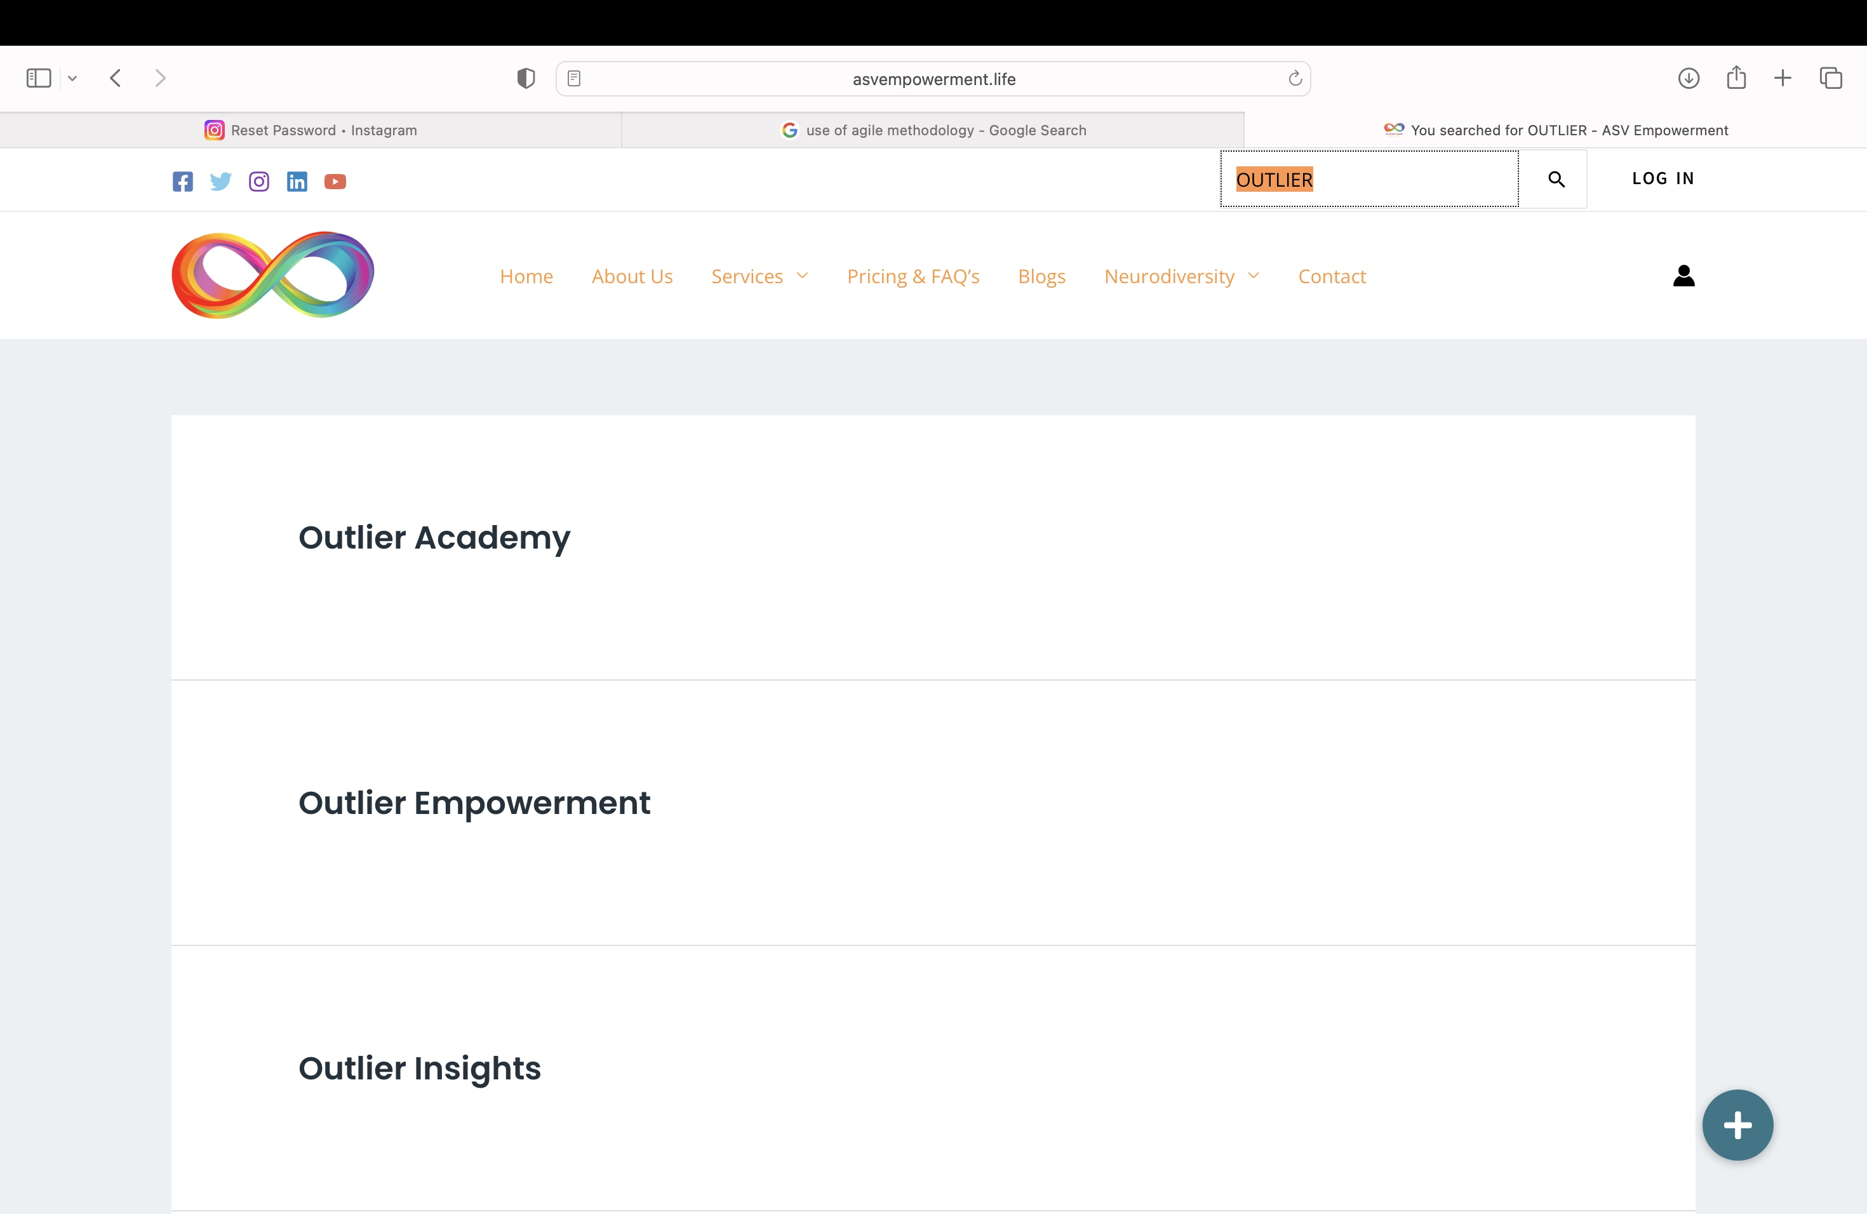
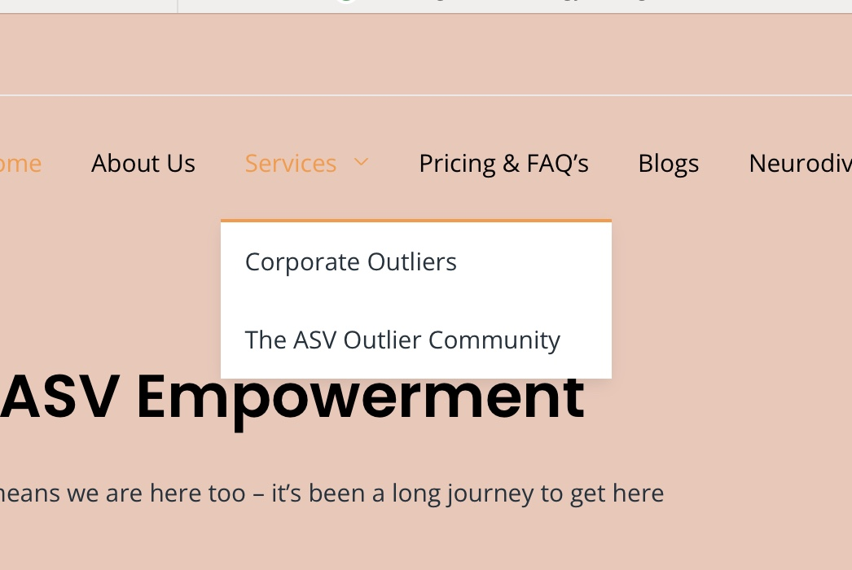
Subpages divide the
Categories into a neat allocation of choice among many choices.
The colors and pictures
Kept serene and minimalist
Incorporation of light and dark
contrasting colors .
In built SOE with 75% accuracy measure to easily trace key words that the customer wants to find

Slide 16










Features
Access to extensive resources that covers a diverse range of topics related to Neurodiversity.
Secured and private online environment that respects user confidentiality.
Notifications for upcoming events, workshops and webinars dedicated to Neurodiversity
Subscription to learning modules designed to promote understanding and empathy for neurodiversity.
Coaching and consulting available with experts and peers through online sessions and services.
“Get in Touch” to contact us for any inquiries, feedback or support.
Newsletter signup for joining vibrant community of neurodiversity advocates and supporter.
User-friendly navigation that makes exploring the website effortless.
Search bar to explore and search through the website and discover resources based on the keyword.
Quiz!

Slide 17
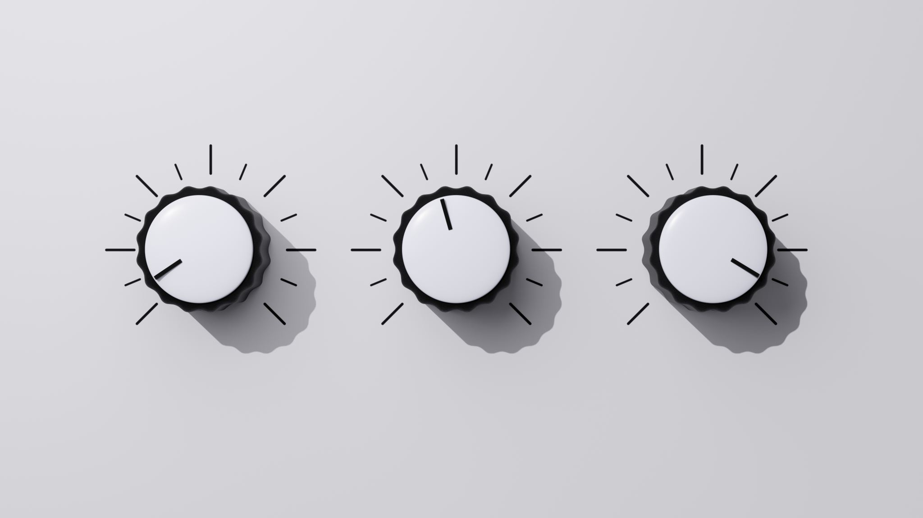
device Compatibility

Slide 18
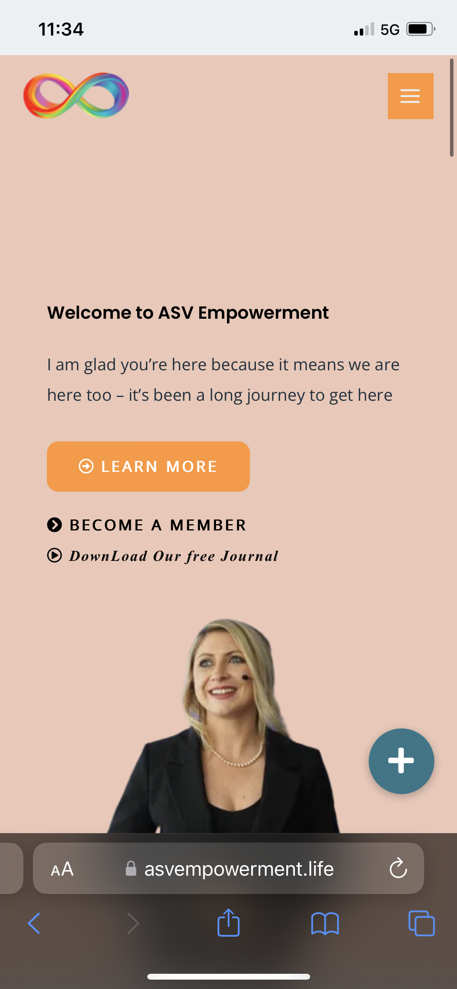
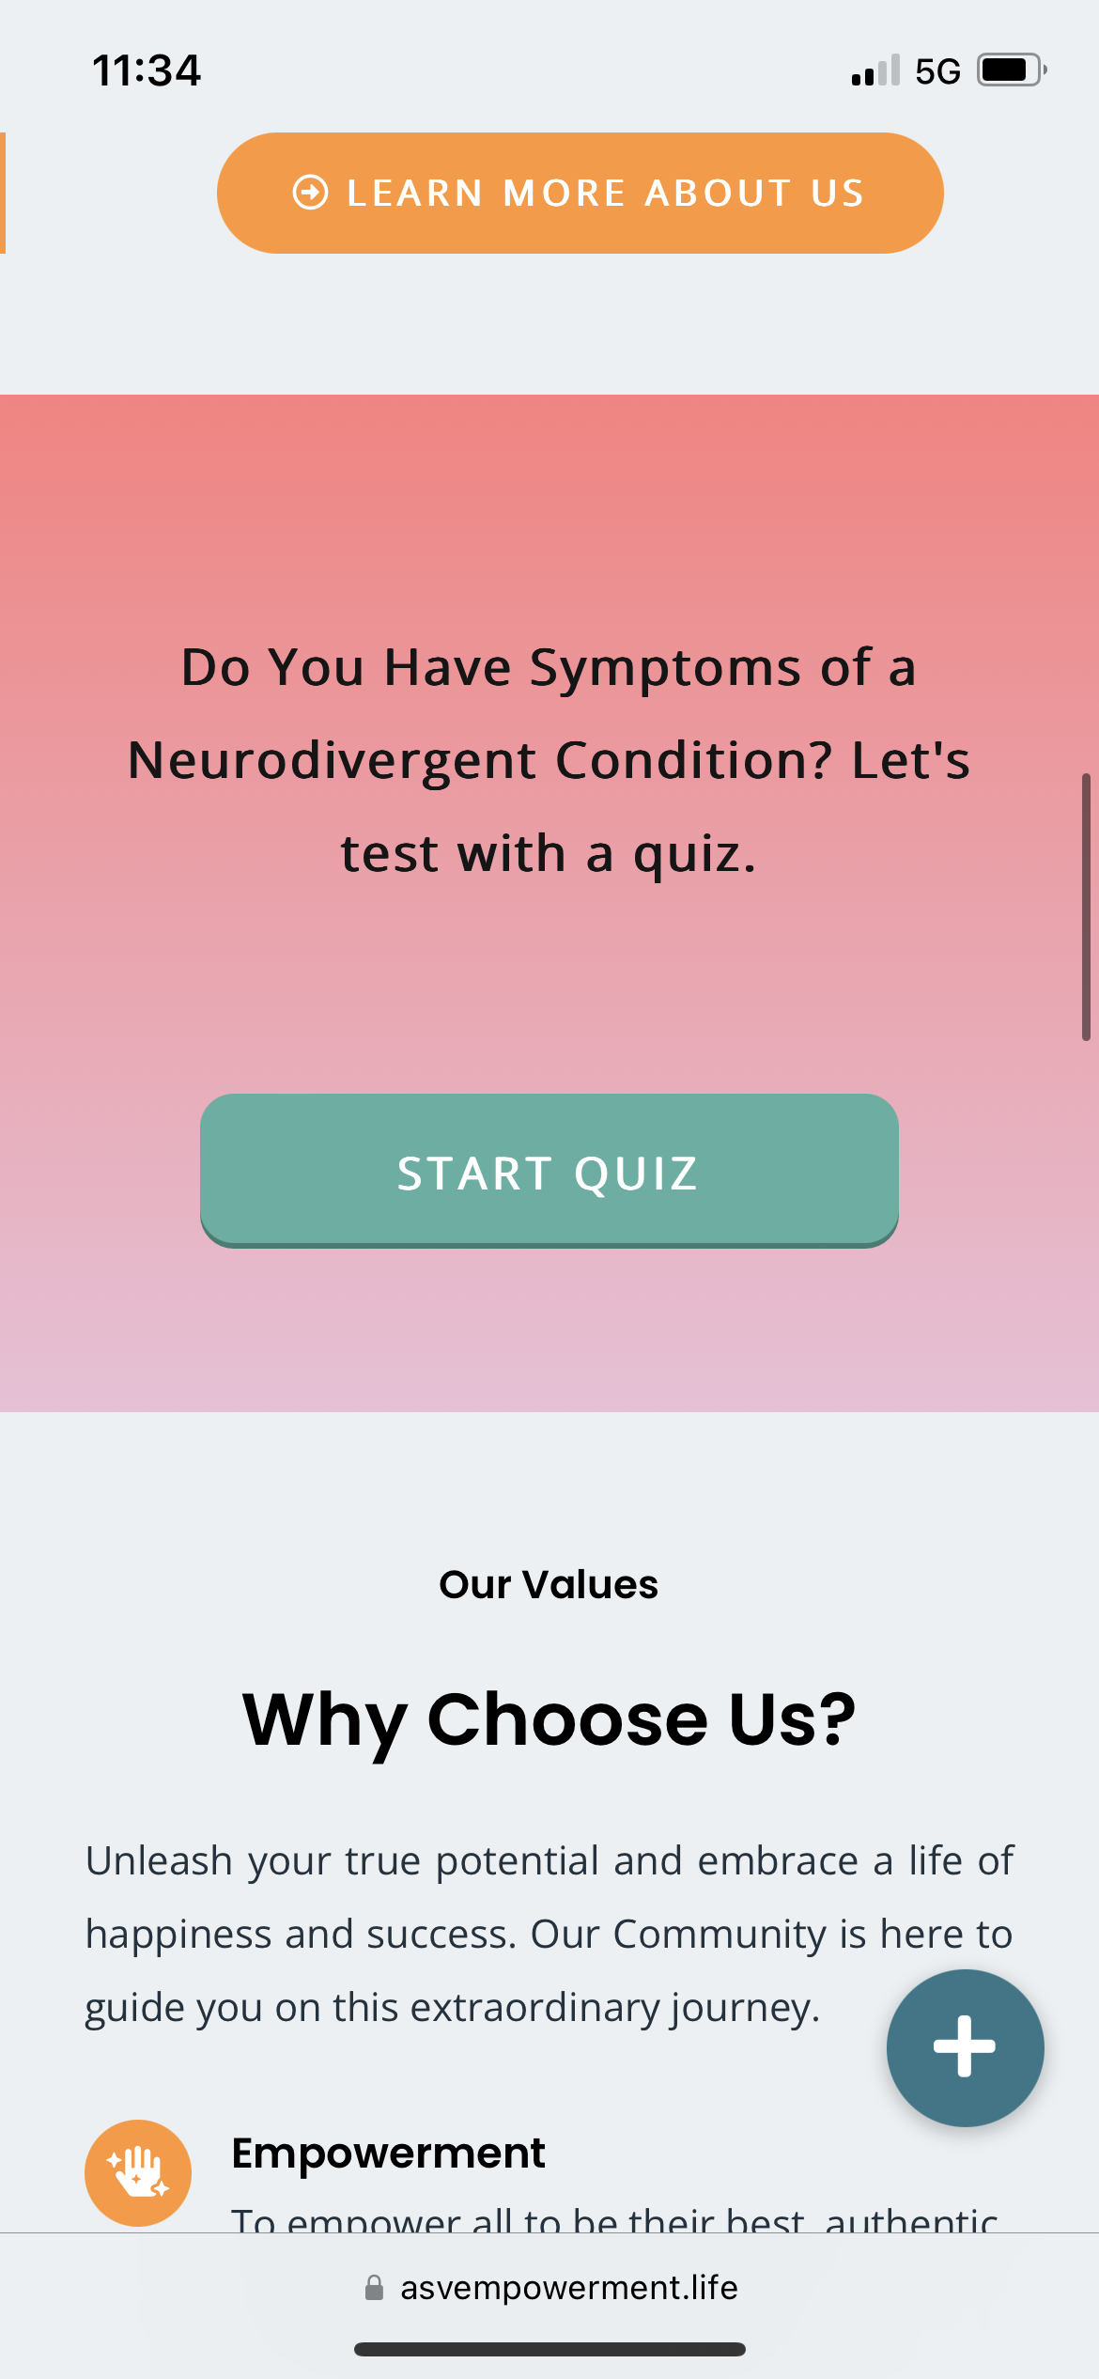
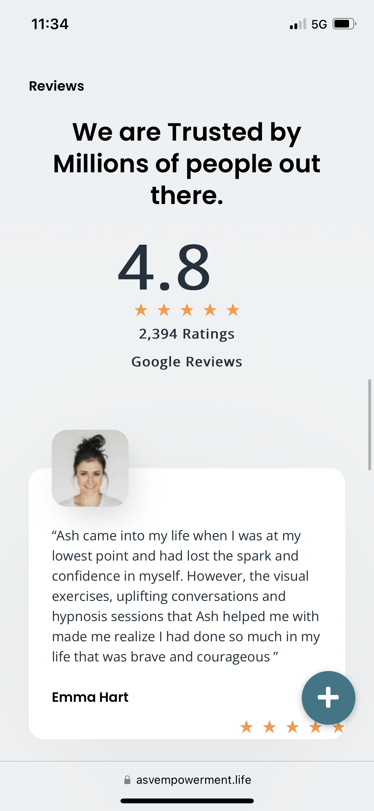
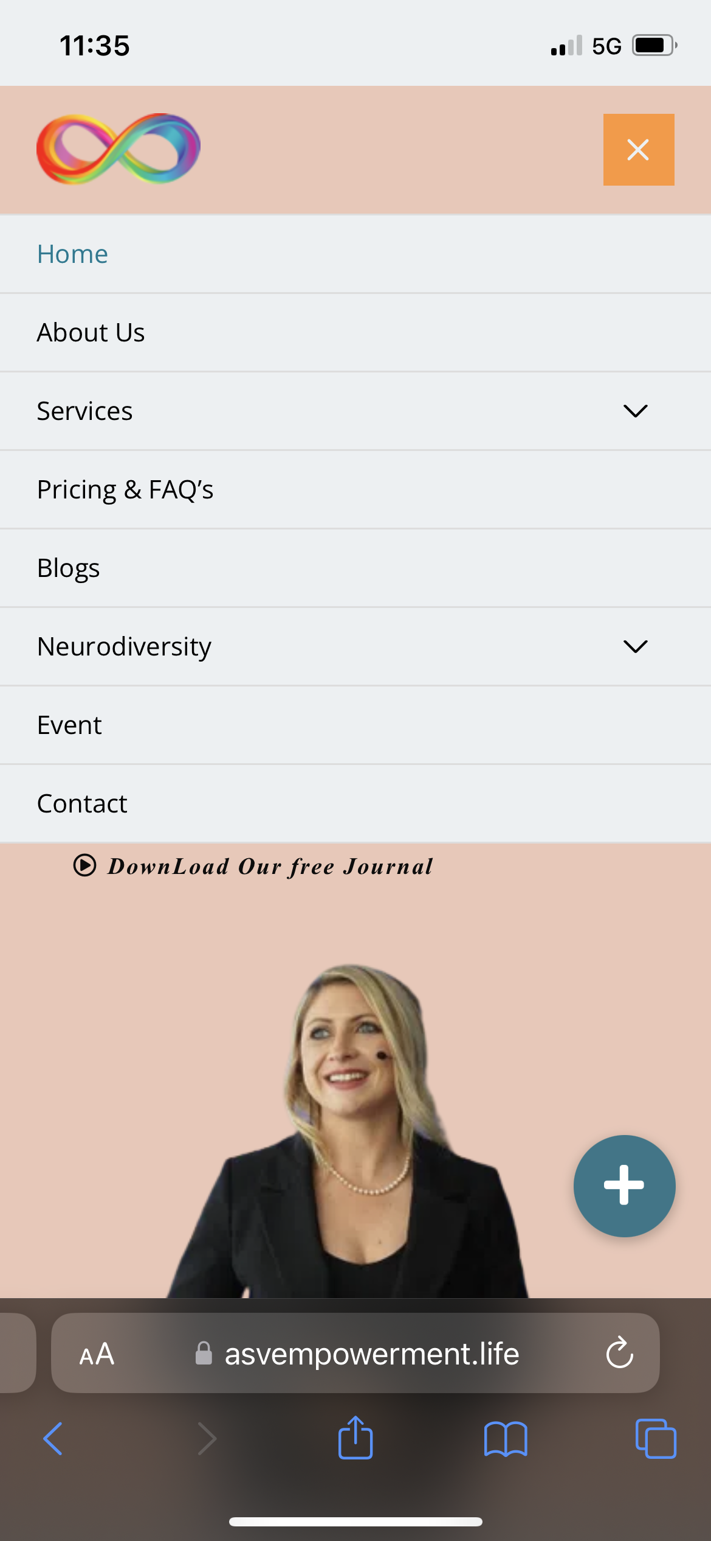
Mobile view

Slide 19
Solution demonstration

Slide 20

Functionalities

Slide 21

CONTACT PAGE

Slide 22

NEWSLETTER SIGN UP

Slide 23

SEARCH BAR

Slide 24
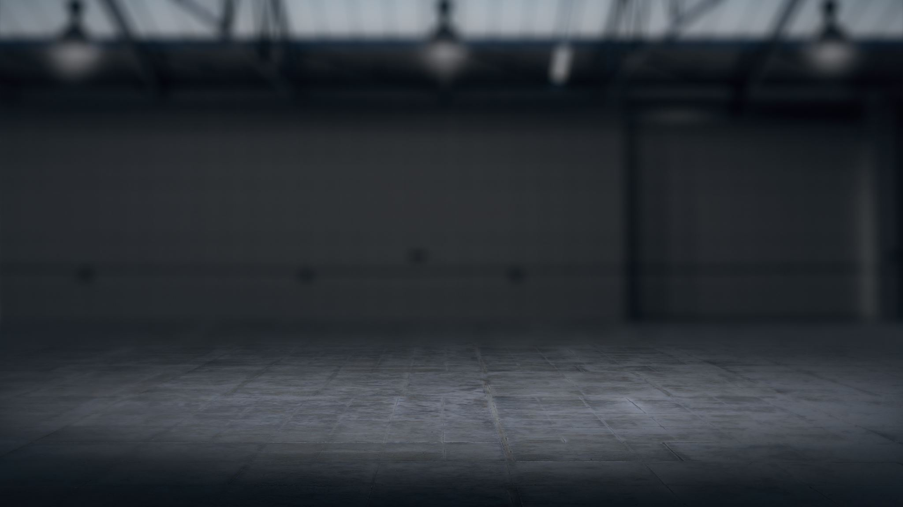
PAYMENT GATE WAY

Slide 25

QUIZ

Slide 26
recommendation
WE RECOMMEND THE CLIENT TO FURTHER EXTEND THIS WEBSITE IN THE FUTURE TO INCORPORATE THE SERVICE MODULES
HAVE AN UPDATED EVENT PAGE FEATURING THE TRENDING GUESTS AND LIVE EVENT ADVERTISEMENTS WITH HIGH SEO.
A BETTER DESIGN , MORE CONSISTENT AND COLORFUL (WE COULD HAVE INVESTED MORE TIME TO UPGRADE WITH A BIGGER SCHEDULE)
MORE INCORPORATION OF PICTURES, VIDEOS AND GRAPHIC DESIGNS BESPOKELY CREATED BY ARTISTS FOR THE BRAND.

